Slide 1
EXO_
SALIENCE
AN EXOPLANET CLASSIFIER WITH SALIENCY HEATMAPS
NATHAN INBAR && KAREN XU

Slide 2
MISSION STATEMENT
Problem:
Deep Learning is a ‘black box’ - we need insight for why a classifier makes its decisions.
Our Goal:
Provide a web interface for researchers to classify exo -planets, and visualize classifier ‘salience’.

Slide 3
Data Pre-Processing
Neighbour planet point removal
Iterative Light Curve flattening
Phase Folding
Global / Local view binning
Methodology courtesy of Christopher J. Shallue and Andrew Vanderburg via Astronet

Slide 4
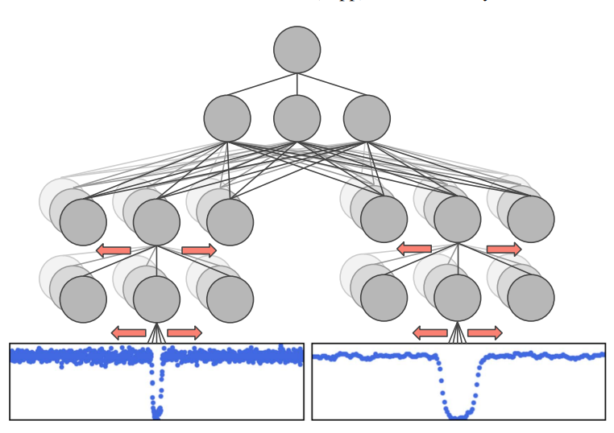
THE MODEL
LINEAR REGRESSION MODEL ->
CNNS ->
Identifying Exoplanets with Deep Learning: A Five-planet Resonant Chain around Kepler-80 and an Eighth Planet around Kepler-90

Slide 5
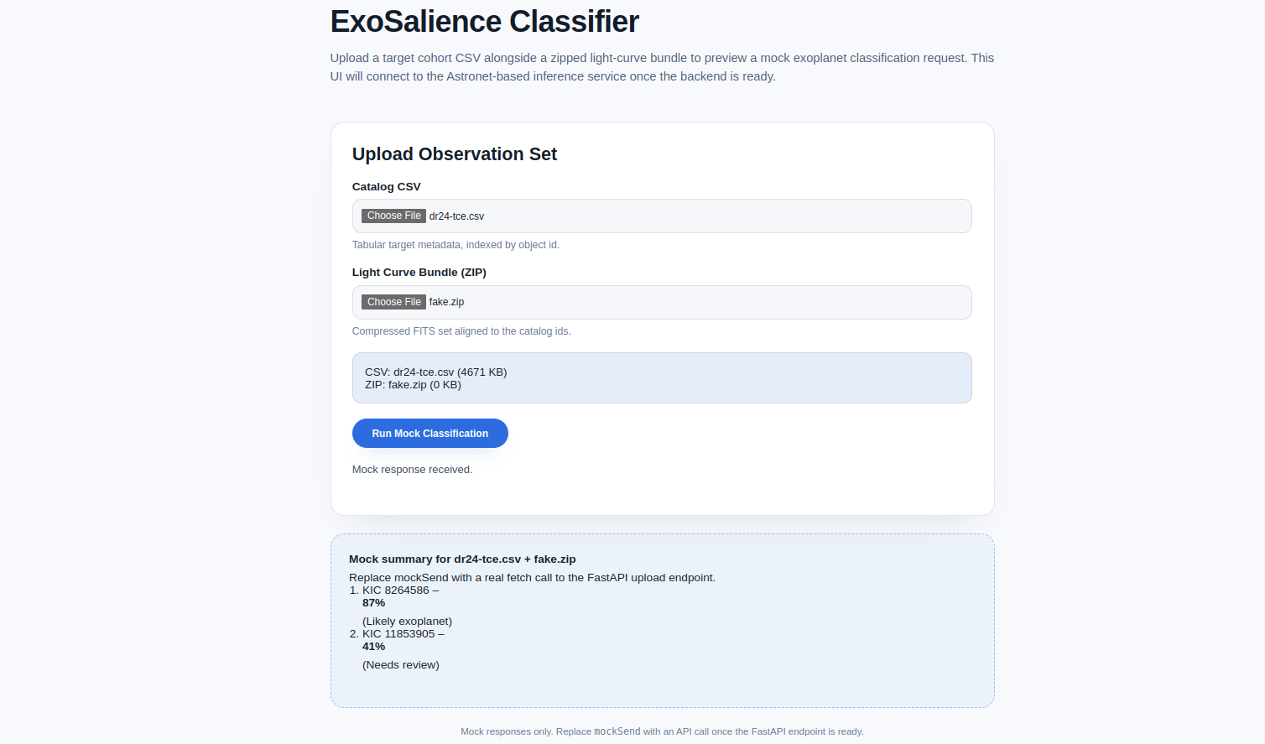
Interface

Slide 6
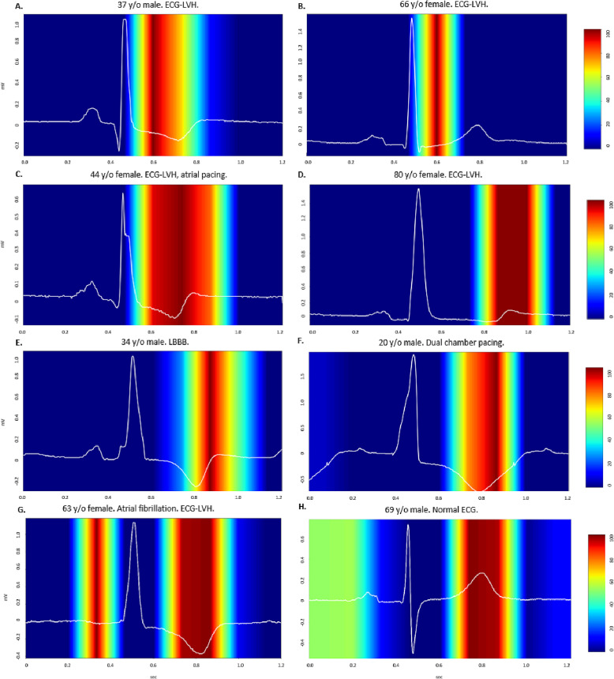
Interface
*example illustration
INSIGHT:
WHICH PARTS OF THE LIGHT CURVE WERE THE MOST IMPORTANT FOR DETERMINING THE CLASSIFICATION?

